Slide 1
VESTIGE
WOMEN’S HEALTH
3rd October, 2018

Slide 2
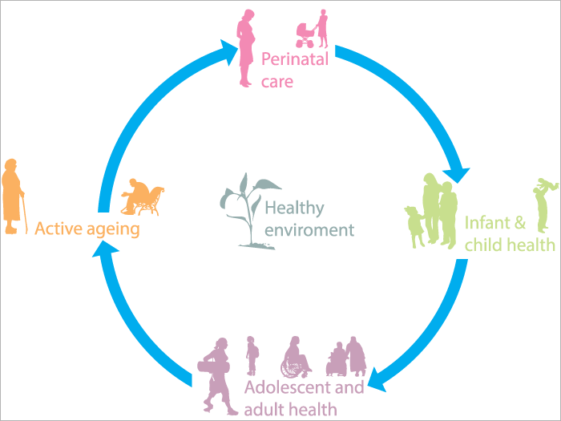
WOMAN Life Cycle
Major life transitions such as pregnancy, motherhood and menopause can create physical and emotional stress in women
Negative life experiences –infertility and perinatal loss, poverty, discrimination, violence, unemployment and isolation – also impact on women's mental health and wellbeing

Slide 3
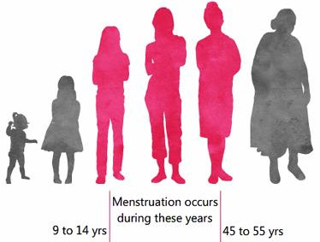
PHASES of Women’s Life
Menstrual cycle is part of the women body’s way of preparing itself for a possible pregnancy each month
Women usually have periods between the age group of 13-50 years (approx.) & the body undergoes through many physiological & psychological changes during this phase
Recent studies suggest that the age of menarche is often slightly reduced in girls who are subject to emotional stress & so is the case with the menopause

Slide 4
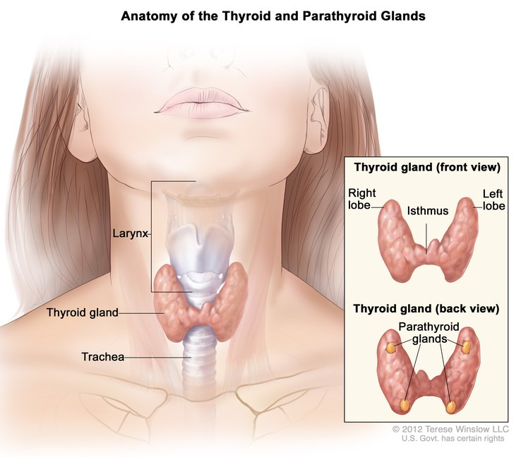
COMMON Diseases among Women
Anemia
It is a condition that develops when your blood lacks enough healthy red blood cells or hemoglobin
Women in the childbearing years are particularly susceptible to iron-deficient anemia because of the blood loss from menstruation and the increased blood supply demands during pregnancy
Thyroid
Thyroid is a small butterfly-shaped gland found at the base of your neck, just below your Adam's apple
The thyroid hormone controls body's metabolism
Symptoms
Fatigue, hair loss, excess weight gain/loss, muscle weakness, dry/thinning of hair, joint pain, puffy face, hoarse voice etc.

Slide 5
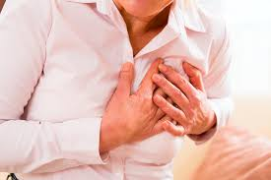
COMMON Diseases among Women
Cardiovascular Diseases
Heart disease is the most common cause of death for both women and men. One challenge is that some heart disease symptoms in women may be different from those in men.
Symptoms:
Chest pain, shoulder pain, nausea, shortness of breath, Severe headache, fatigue, vision problems, difficulty breathing, blood in the urine and pounding in the chest.
Breast cancer
Breast cancer is the most common cancer in women
It begins in the tissues of the breasts. The cancer cells may form a tumor. (Note: Not all tumors are cancerous)
Symptoms:
A lump in or near a breast or in your arm
Thick or firm tissue in or near your breast or under your arm, a change in size or shape of your breast.

Slide 6
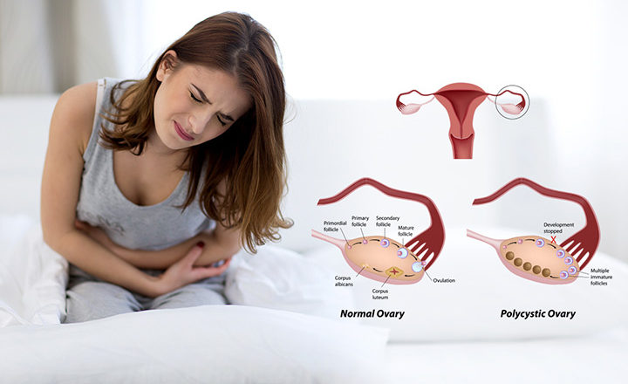
COMMON Diseases among Women
PCOD
PCOD or PCOS (Polycystic Ovarian Disease or syndrome) is a medical problem in which hormonal levels of estrogen and progesterone gets disturbed. This induces growth of small cysts in the ovaries.
Symptoms
Excessive hair on body and face, weight gain, abnormal periods, Pain and bleeding during periods, Despondency and anxiety, Problems pertaining to fertility and pregnancy.
Osteoporosis
It is a condition in which bone density decreases
It is a major health concern for women especially after menopause
One of every 2 women over 50 suffer a fracture related to osteoporosis in their lifetime
Symptoms
Back pain, caused by a fractured or collapsed vertebrae, loss of height over time, a stooped posture, a bone fracture that occurs much more easily than expected.

Slide 7
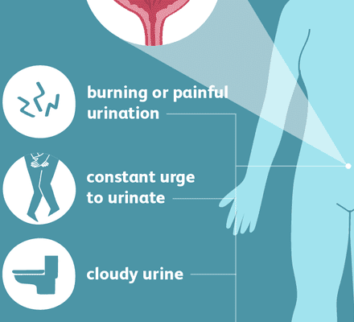
COMMON Diseases among Women
Urinary Tract Infection
Urinary tract infections are common in women, and many women experience more than one infection during their lifetimes
Women have shorter urethra than men, which shortens the distance that bacteria travels to reach the bladder, therefore the infections are more commonly found in women
Symptoms:
Burning with urination
Increased frequency of urination without passing much urine
Increased urgency of urination
Bloody urine
Cloudy or milky urine
Urine that has a strong odor
Pelvic pain in women

Slide 8
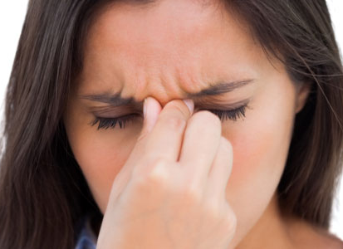
HORMONAL Imbalance
Hormones are the body’s chemical messengers
They travel around the bloodstream telling tissues and organs what to do
They help control many of your body’s major processes, including metabolism and reproduction
When you have a hormonal imbalance, you have too much or too little of a certain hormone
Even tiny changes can have serious effects on the body

Slide 9
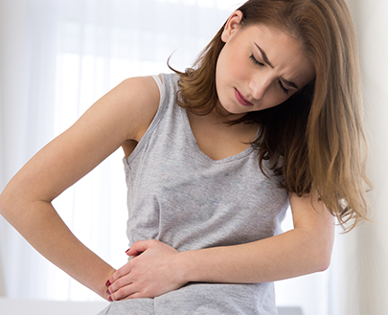
CAUSES of Hormonal Imbalance
Hypothyroidism or hyperthyroidism
Diabetes
Stress
Eating disorders
Medications, like birth control pills or others
Injury or trauma
Menopause
Pregnancy or breastfeeding
PCOS / Irregular cycles
Premature menopause
Certain types of tumors (benign or cancerous)

Slide 10
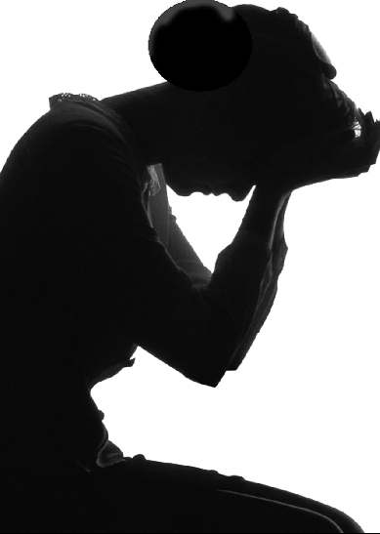
SYMPTOMS of Hormonal Imbalance
Weight gain
Dry skin
Water retention
Pain, muscle stiffness, or swelling in your joints
Depression, nervousness, anxiety, or irritability
Decreased sex drive
Infertility
Heavy or irregular periods, including missed periods
Excessive hair on the face, chin, or other parts of the body
Acne on the face, chest, or upper back
Thinning hair or hair loss
Darkening of skin, especially along neck creases
Vaginal dryness

Slide 11
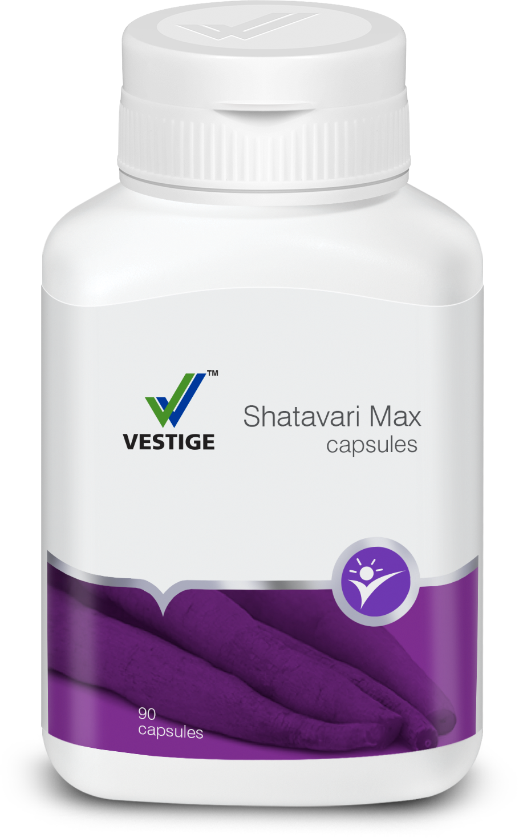
VESTIGE SHATAVARI MAX
INTRODUCING

Slide 12
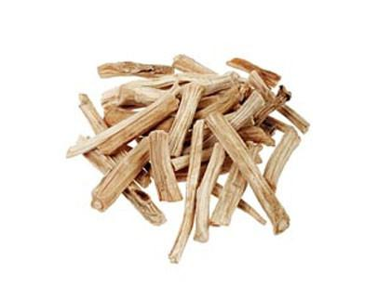
SHATAVARI
Shatavari or Aragus racemosus is known as the "Queen of the Herbs" for female health
It has been used for 1000's of years as a general female tonic and hormone balancer
Shatavari has long been used to support women reproductive health by encouraging circulation, as well as healthy nervous system and hormonal function
Shatavari's main constituents are saponins that suggest its use as an oestrogen regulator
This support is not only for the young woman, but also for women in their middle and elder years, to help them gracefully transition through the natural phases of life

Slide 13
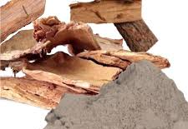
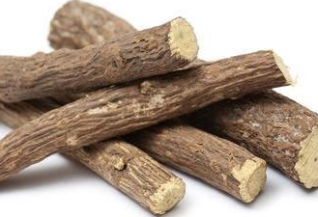
COMPOSITION of Vestige Shatavari Max
PICTURE | INGREDIENTS | FUNCTIONS
 | Shatavari | Helps in balancing hormones, supports digestion and rejuvenates the reproductive system
 | Ashoka | Found effective in menstrual cramps. It stimulates the uterus making the contractions frequent and prolonged (during the monthly cycle and childbirth). This makes it helpful in uterine hemorrhagic conditions like menorrhagia, and metrorrahagia (irregular bleeding during and after menstrual cycle). An excellent remedy for irregular menstrual cycles and bleeding disorders.
 | Licorice | Licorice helps to restore regular ovulation in women who have irregular periods. It also helps support PCOS. It may help to minimize menopausal symptoms by compensating for the natural decline in estrogen levels following menopause.

Slide 14
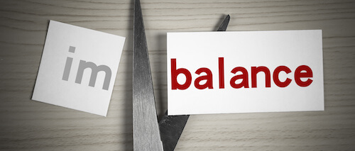
BENEFITS of Vestige Shatavari Max
Vestige Shatavari Max is a powerful combination of 3 ingredients has an overall benefit on the female reproductive and hormonal system:
Helps in maintaining a healthy female reproductive system
  Helps to regulate menstrual cycles, manage PMS symptoms, alleviate menstrual cramps and helps to control the amount of blood lost
  Helps with fluid retention and with the uncomfortable bloating before periods
  It nourishes the female reproductive system from within to relieve menopause symptoms such as vaginal dryness, hot flashes and insomnia
  It also stimulates and balances the production of happy hormones that helps to reduce mood swings, irritablility and menopause induced depression
Supports healthy levels of breast milk production during lactation
Promotes healthy energy levels and strength
It also acts an adaptogen that helps the body cope with physical and emotional stress
Soothing effect on the digestive tract
Supports the immune system

Slide 15
DOSAGE of Vestige Shatavari Max
One capsule thrice daily or as advised by the physician
Contraindications
There are no side effects associated with Shatavari use, however it should be avoided in some instances:
Those with allergic reactions to asparagus should not use the herb, as it is a member of the asparagus family
Women with high prolactin levels or the endocrine disorder should also avoid using Shatavari as it may promote the production of prolactin
Shatavari can increase Kapha, so those with excess Kapha should avoid using the herb
*Always consult with a medical practitioner to treat any serious medical condition

Slide 16
Vestige Shatavari Max
90 capsules
Veg Capsules
MRP Rs. 545.00
DP Rs. 460.00
BV 276
PV 15.33

Slide 17
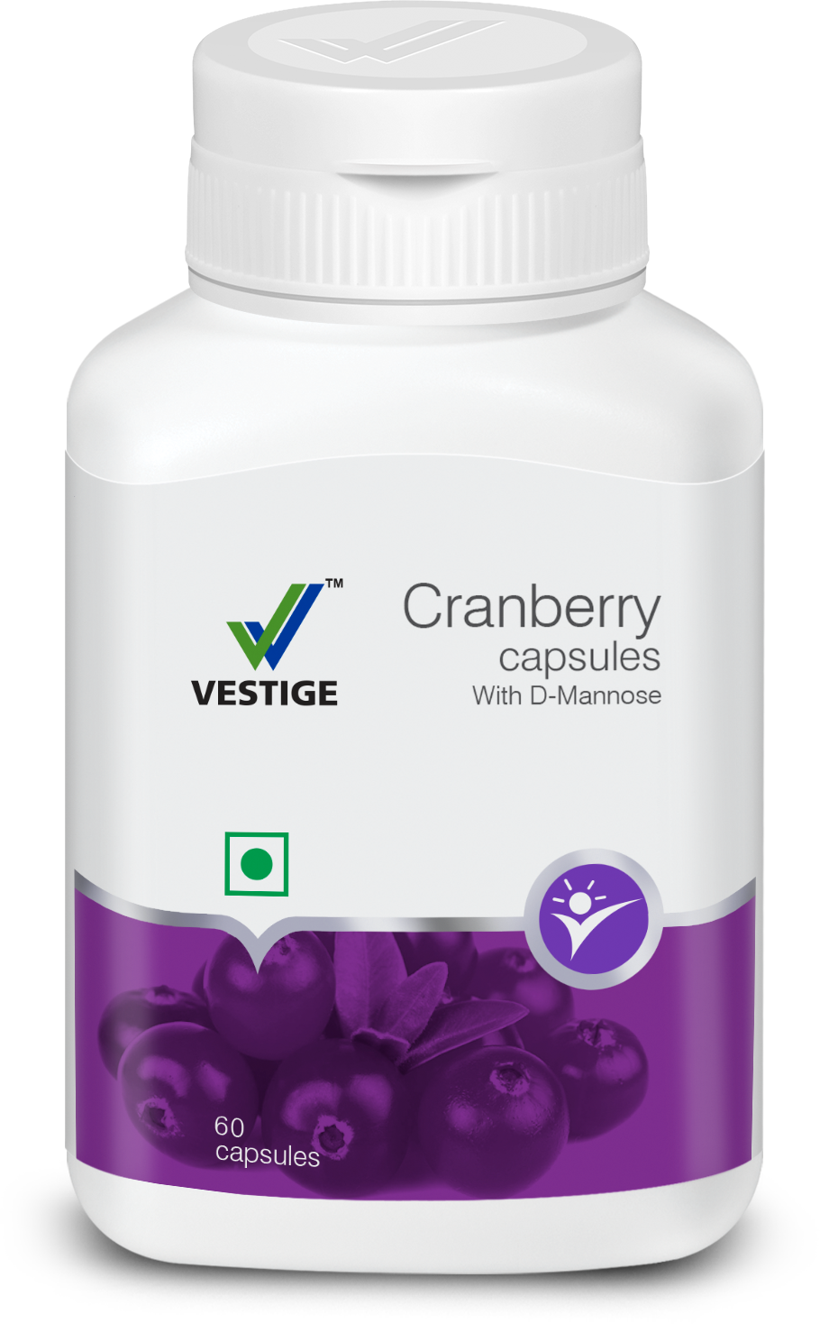
VESTIGE CRANBERRY with D-Mannose

Slide 18
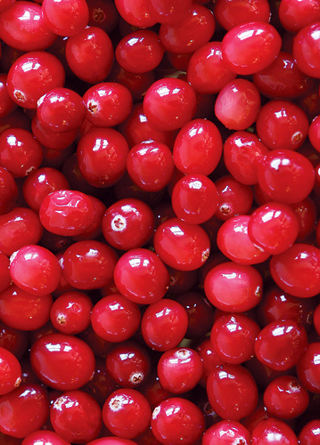
CRANBERRY & D-MANNOSE
Cranberry is a native evergreen shrub that grows throughout North America
Historically, cranberry fruits or leaves were used for bladder infections, stomach and liver disorders, wound healing and other conditions
It is most commonly used for preventing UTI
Cranberries owe their superpowers to the presence of flavonoids, anti-inflammatory agents, organic acids, and polyphenolic compounds, along with high amounts of vitamin C and fibre
It contains potent antioxidants compared to other fruits and vegetables
D-mannose is a kind of sugar that is related to glucose. It is naturally found in many fruits such as apples, oranges, peaches, blueberries and cranberries
The combination of both Cranberry and D-Mannose helps to prevent the recurrence of UTI

Slide 19
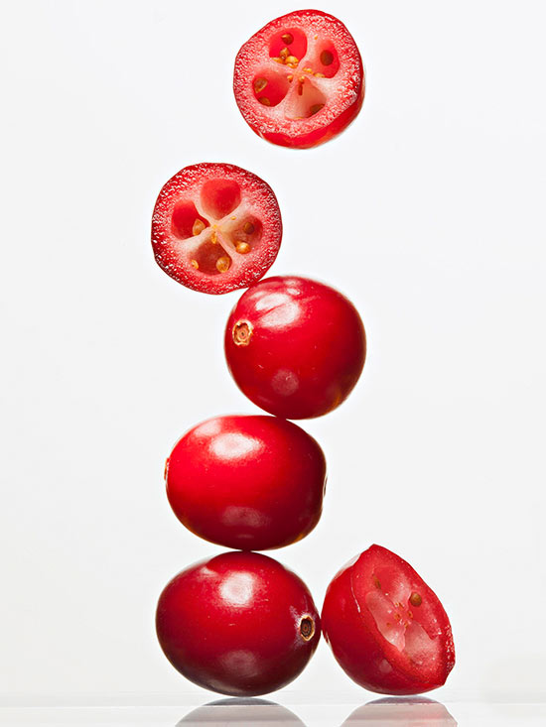
BENEFITS of Vestige Cranberry
Vestige Cranberry is a unique combination of two powerful ingredients – Cranberry extract and D-Mannose
D-mannose and proanthocynidins in cranberries with added D-Mannose promotes maintenance of healthy urinary tract
Cranberries have citric acid which helps in maintaining bladder complications
D-mannose inhibits certain kind of bacteria to adhere to the walls of the urinary tract thus preventing recurrence
D-Mannose also acts as a prebiotic that helps to promote ‘good’ bacteria in the digestive system
It has anti-aging properties and supports healthy skin and hair too

Slide 20
DOSAGE of Vestige Cranberry
One capsule once or twice daily with meals
Who should take Vestige Cranberry
People on continuous travel using public toilets often
People with history of UTI
People suffering from UTI (along with doctor’s prescribed medicines)
Teenagers using college/school/hostel toilets often
Sexually active women
Women suffering from leucorrhoea (white/yellowish discharge)
People with less water intake

Slide 21
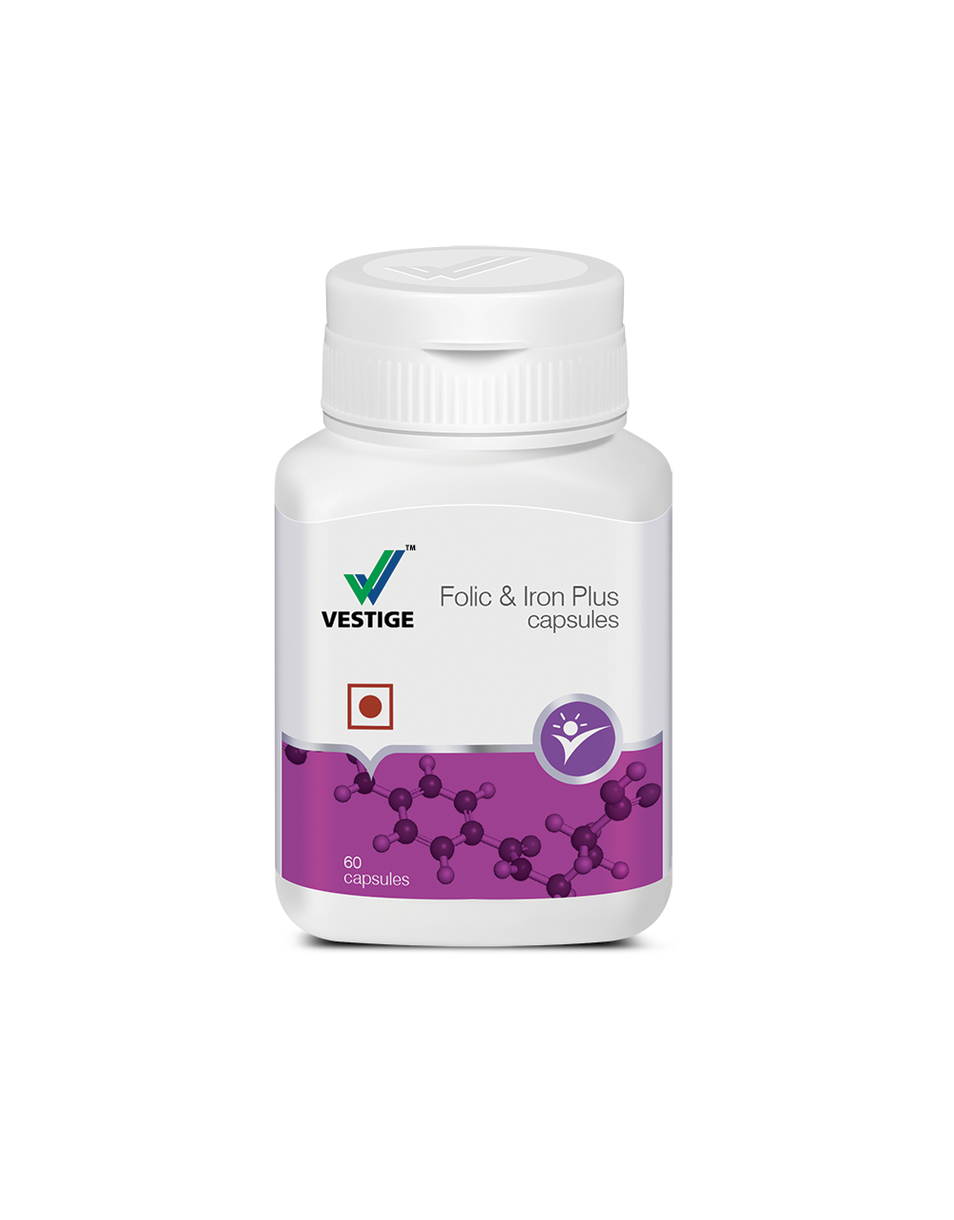
VESTIGE FOLIC & IRON PLUS

Slide 22

CAUSES of Iron Deficiency in Women
Increased requirement during
  Menstruation
  Pregnancy
  Lactation
Decreased intake of Iron
  Lack of balanced diet
  Poor intake
Increased loss of Iron in
  Post operative patients
  Blood loss during surgery
  Infections
Decreased absorption of Iron
  Dietary factors - (with tea/coffee/milk/carbonated drinks)
  Patients with kidney problems
IRON

Slide 23
Vestige Folic & Iron Plus
The goal of providing iron – folic acid supplements is to restore normal levels of iron and to replenish hemoglobin levels
Poor dietary intake of iron, accelerated increase in requirements of iron e.g. during pregnancy & lactation, adolescent females and elderly can benefit with the supplementation of iron and folic acid
COMPOSITION
Ferrous Fumarate (iron) – 250 mg
  Ferrous fumarate is most absorbable form of iron in the body
Folic acid – 1 mg
Vitamin C – 75 mg
Vitamin B12 – 15µg
Zinc Sulphate- 100mg (equivalent to elemental zinc- 22.7mg)

Slide 24
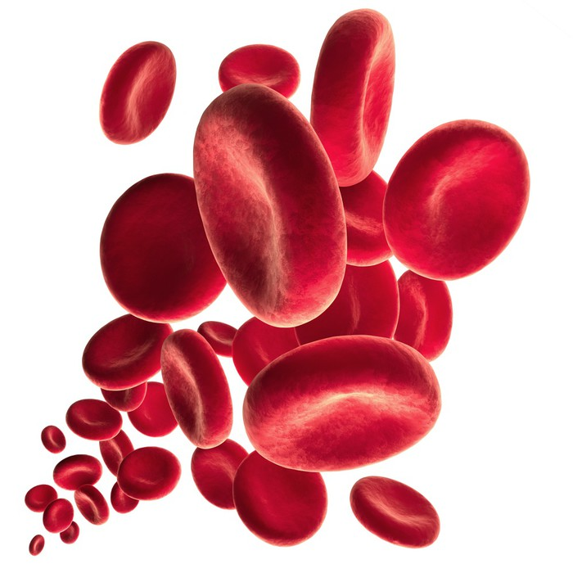
BENEFITS of Vestige Folic & Iron Plus
Iron is an important mineral that the body needs to produce red blood cells (RBCs) and in turn improves hemoglobin levels
Folic acid is needed to form healthy cells, especially RBCs
Women of childbearing age should maintain adequate amounts of folic acid through supplements or diet to prevent birth defects
Vitamin C improves the absorption of iron from the stomach
Vitamin B12 helps in maintaining the health of the nerve cells and for the synthesis of the RBCs
Zinc may help prevent osteoporosis in women during menopause, it also helps to strengthen the immune system
The combination plays an important role in growth & development and contribute to the reduction of tiredness and fatigue

Slide 25
DOSAGE of Vestige Folic & Iron Plus
2 capsules per day
Keep at least 3 hours gap if taking Calcium supplement

Slide 26
Vestige Folic & Iron Plus
Vestige Cranberry
60 capsules
MRP Rs. 280.00
DP Rs. 240.00
BV 144
PV 8
60 capsules
MRP Rs. 1875.00
DP Rs. 1630.00
BV 978
PV 54.33

